Slide 1
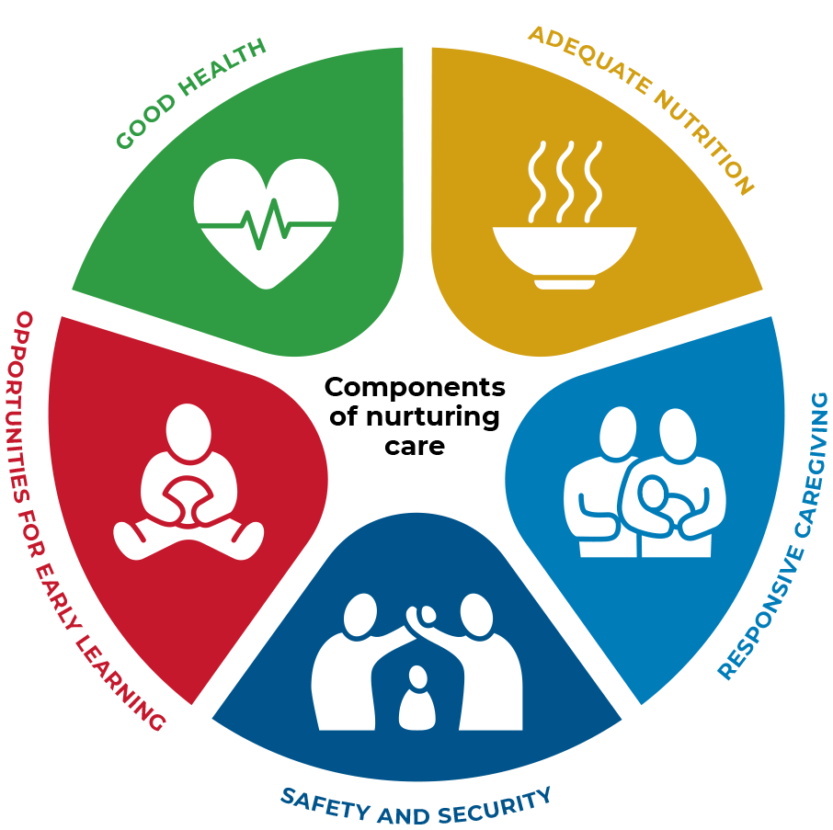
The five components of nurturing care
To reach their full potential, children need the five inter-related and indivisible components of nurturing care.

Slide 2




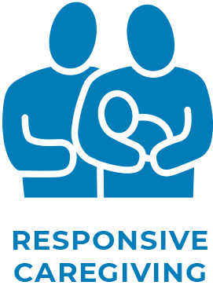
The five components of nurturing care
1
2
3
4
5

Slide 3
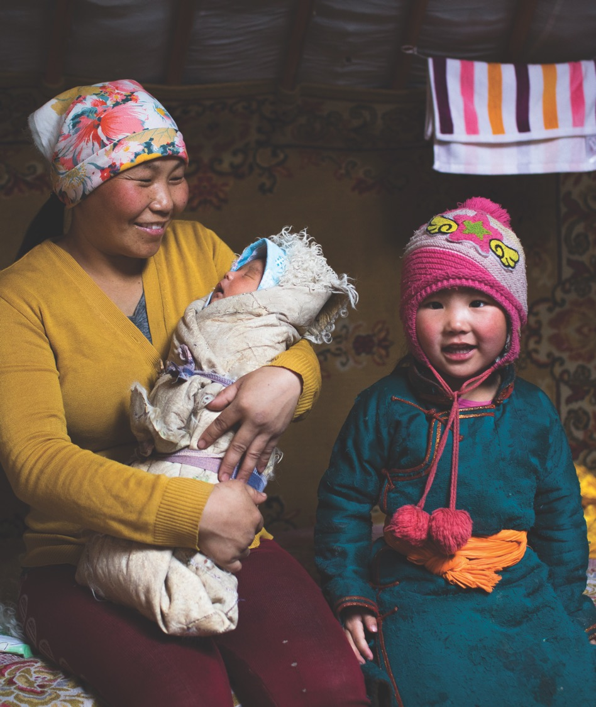

Good health
Refers to the health and
well-being of the children and
their caregivers. Why both?
We know that the physical and mental health of caregivers can affect their ability to care for
the child.
Photo credit:
© UNICEF/UN0198638/Njiokiktjie

Slide 4
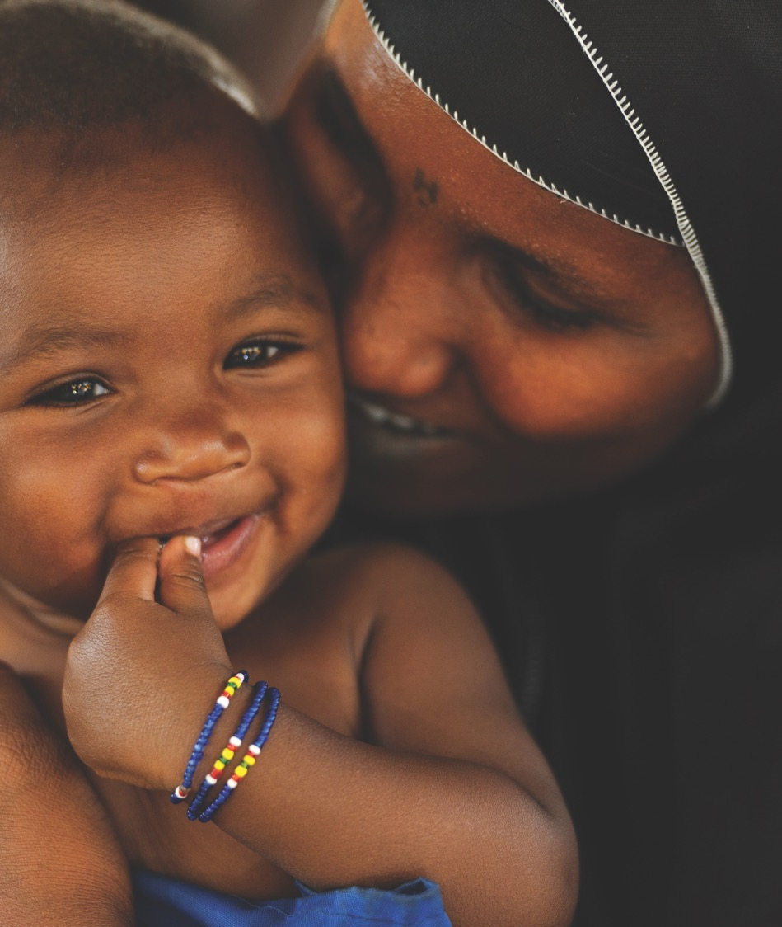

ADEQUATE NUTRITION
Refers to maternal and child nutrition. Why both? We know that the nutritional status of the mother during pregnancy affects her health and well-being and that of her unborn child. After birth, the mother’s nutritional status affects her ability to provide adequate care to her young child.
Photo credit:
Nyani Quarmyne/Panos Pictures

Slide 5
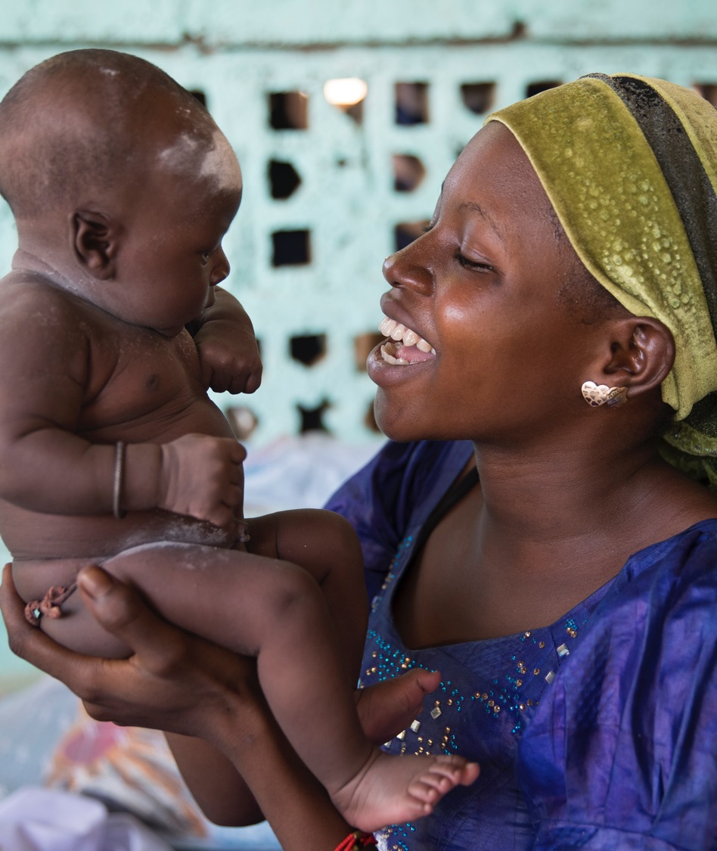

SAFETY AND SECURITY
Refers to safe and secure environments for children and their families. Includes physical dangers, emotional stress, environmental risks (e.g., pollution), and access
to food and water.
Photo credit:
© UNICEF/UN0205718/Njiokiktjien

Slide 6
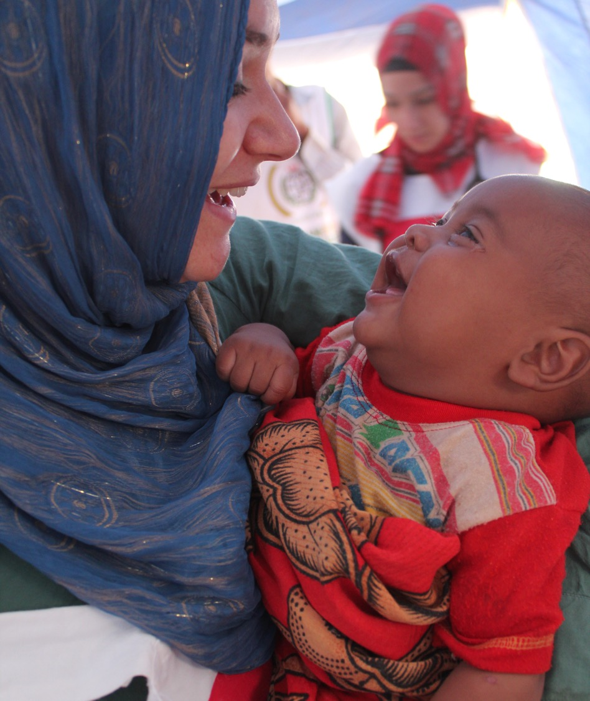

Opportunities FOR EARLY LEARNING
Refers to any opportunity for the infant or child to interact with a person, place, or object in their environment. Recognizes that every interaction (positive or negative)
or absence of an interaction is contributing to the child’s brain development and laying the foundation for later learning.
Photo credit:
Flickr Creative Commons License/IHH Humanitarian Relief Foundation

Slide 7
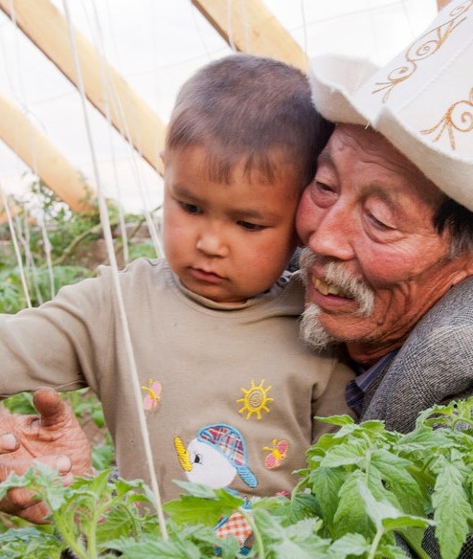

RESPONSIVE CAREGIVING
Refers to the ability of the
caregiver to notice, understand,
and respond to their child’s signals in a timely and appropriate manner. Considered the foundational component because responsive caregivers are better able to support the other four components.
Photo credit:
Aga Khan Development Network/J-L. Ray

Slide 8
Thank you
For more information:
  nurturing-care.org
  ecdan.org
    Join the conversation:
  #NurturingCare
  @NurturingCare

