Slide 1

Bebbo app
6 December 2022

Slide 2
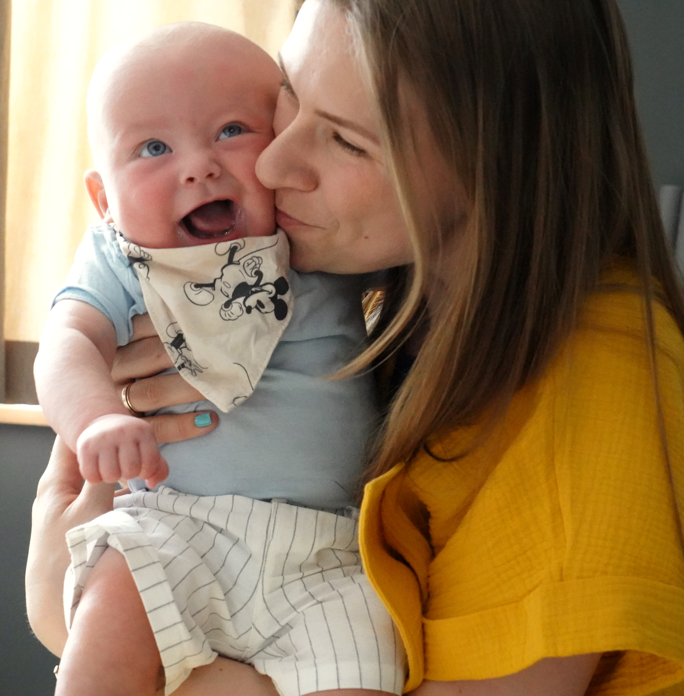
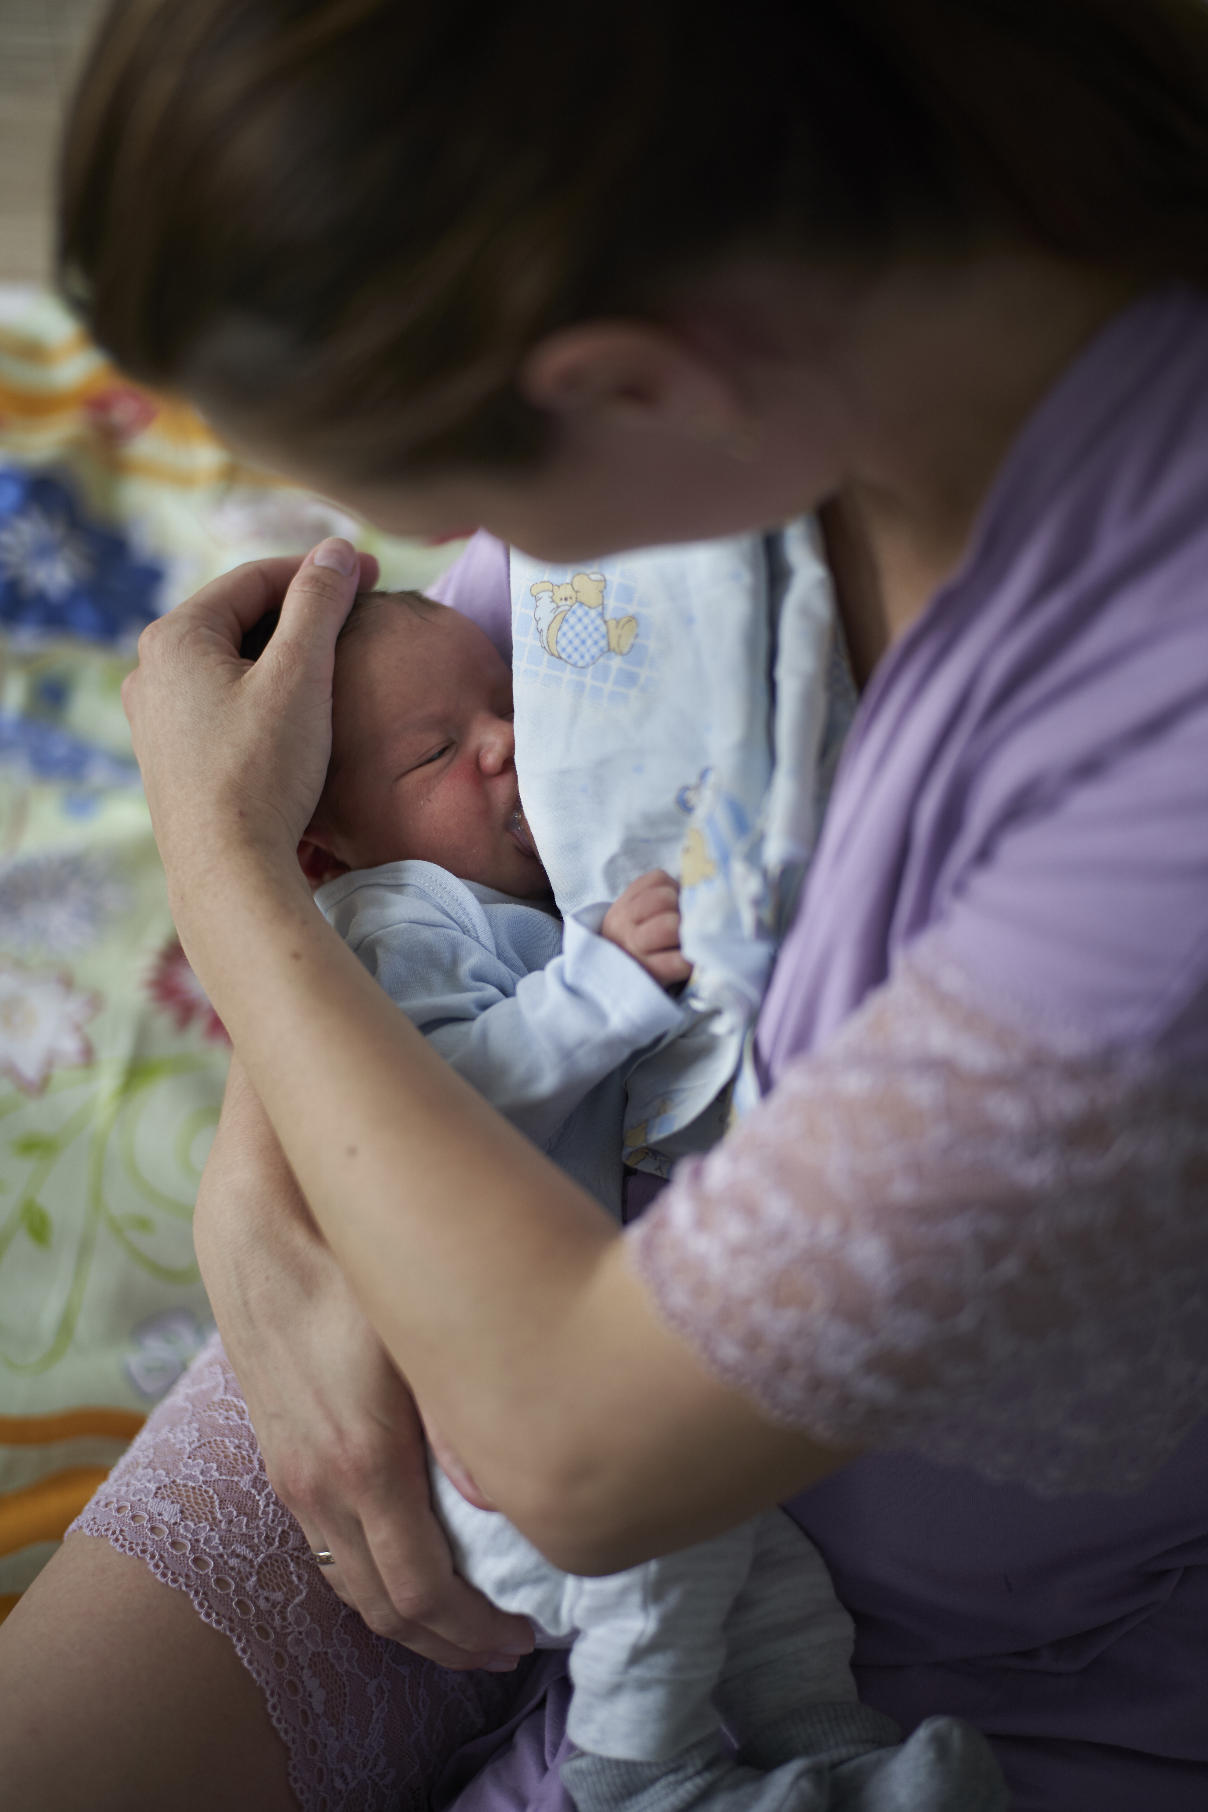
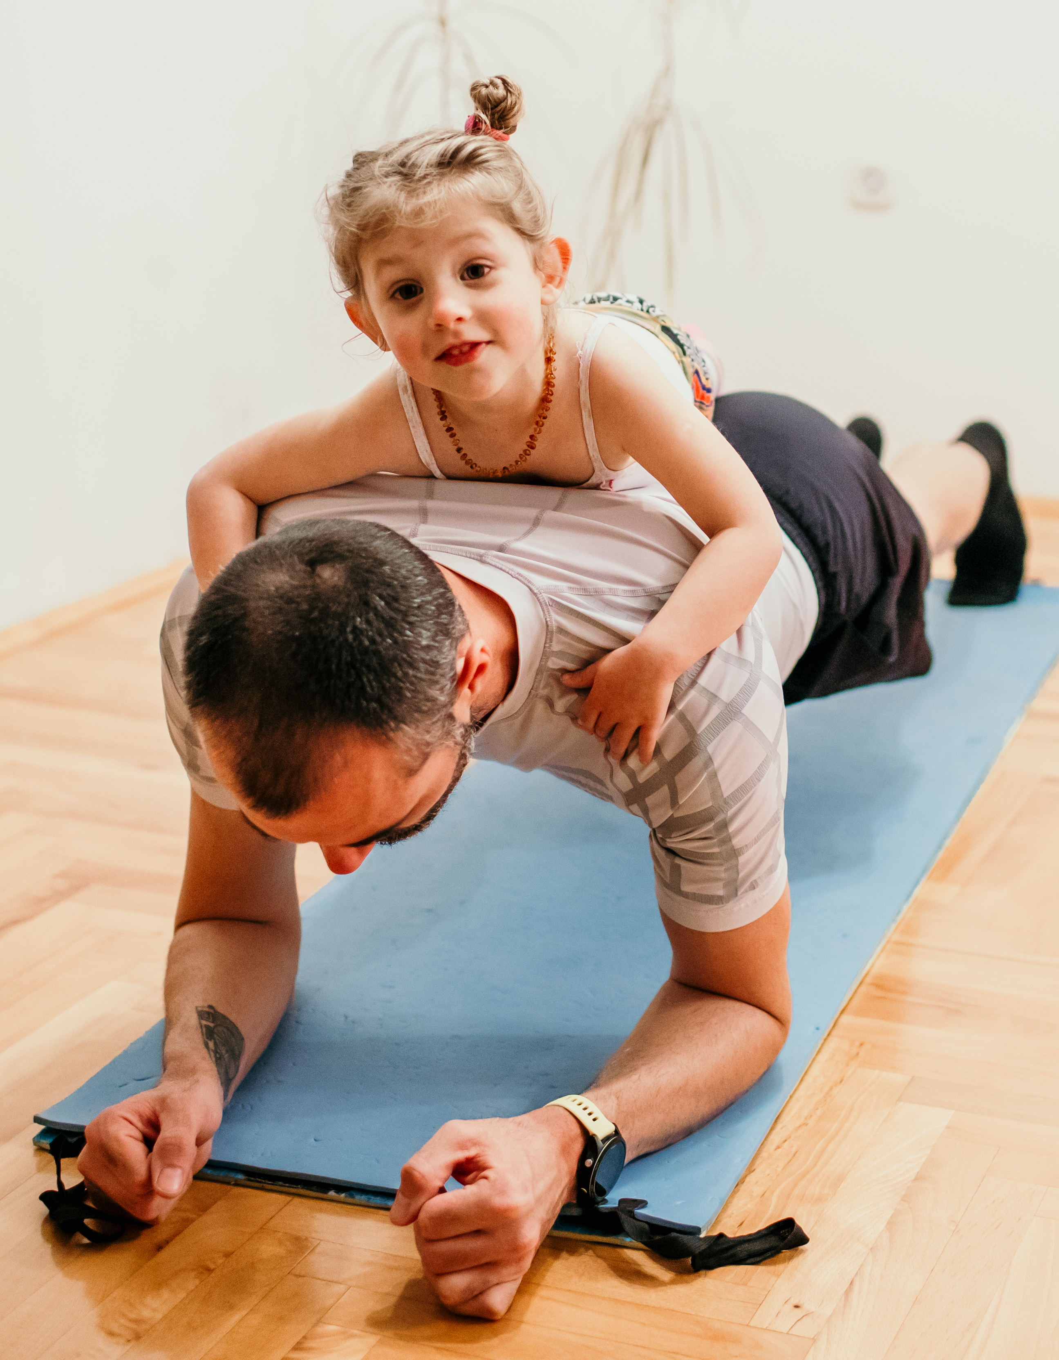

Why Bebbo?
All parents need support to support child health and development
Access to service providers and validated guidance is limited across countries due to COVID-19 and shortage of professionals
Parents use smart phones and need all answers in one place
Existing solutions are not in our language, not customizable, not free and not off-line
Some solutions emerging from the region– Halo Beba prototype developed in Serbia

Slide 3


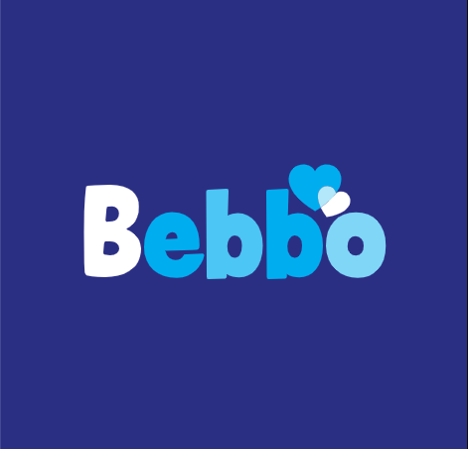


Key considerations
Reach
12 (+2) countries, 19 languages (Albania, Belarus, Bulgaria, Greece, Kosovo, Kyrgyzstan, North Macedonia, Montenegro, Serbia, Tajikistan, Ukraine and Uzbekistan +Moldova and Romania)
Scalability + easy adaptability + multi-lingual content sharing
Country capacity limitations
Partnership with governments and other national partners
Equity
Operates in off- line and low-band environments
Content adapted to local cultural and linguistic contexts
Supports gender socialization
Support for developmental delays

Slide 4
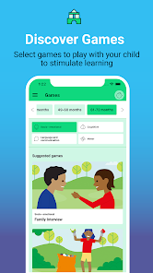


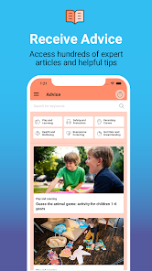

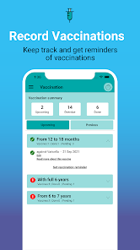


Bebbo app at a glance
Health check-ups
Activities
The individualized mobile application is available in 14 countries and 19 languages and can be used both online and offline when content is pre-downloaded so it can be available when there is no internet access.
Bebbo app informs and empowers parents to be able to make opportune and right decisions regarding the care and development of their child and their own wellbeing.
The app actively encourages parents’ daily engagement in practices that support development through games, notifications, user-friendly navigation modalities and selection of the core content.
Advice
Suggested reads
Vaccination
Tools
4
4

Slide 5
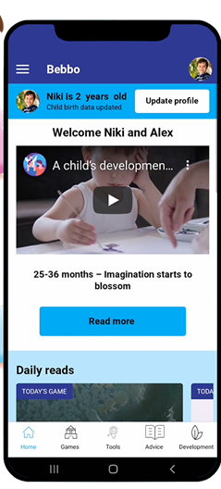
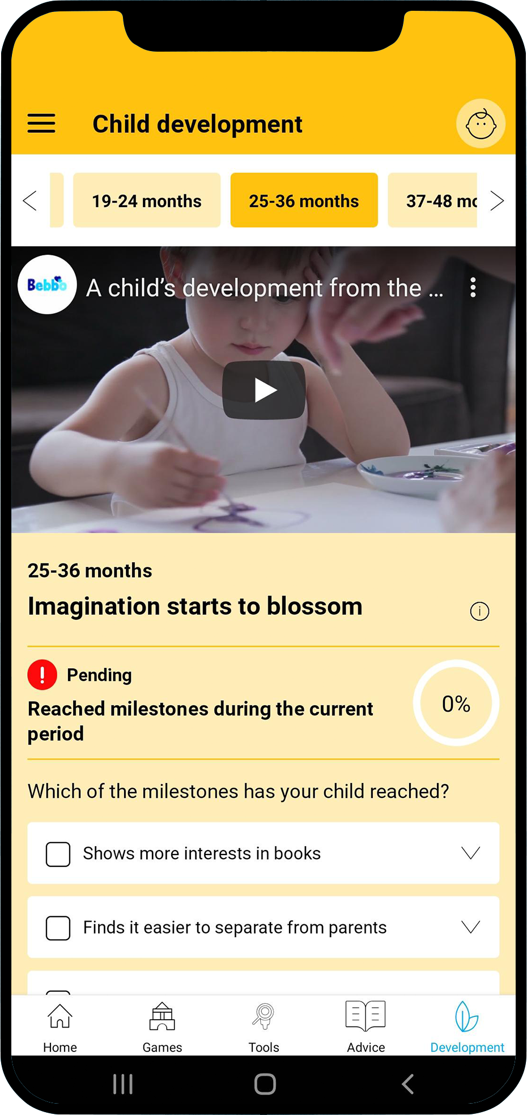
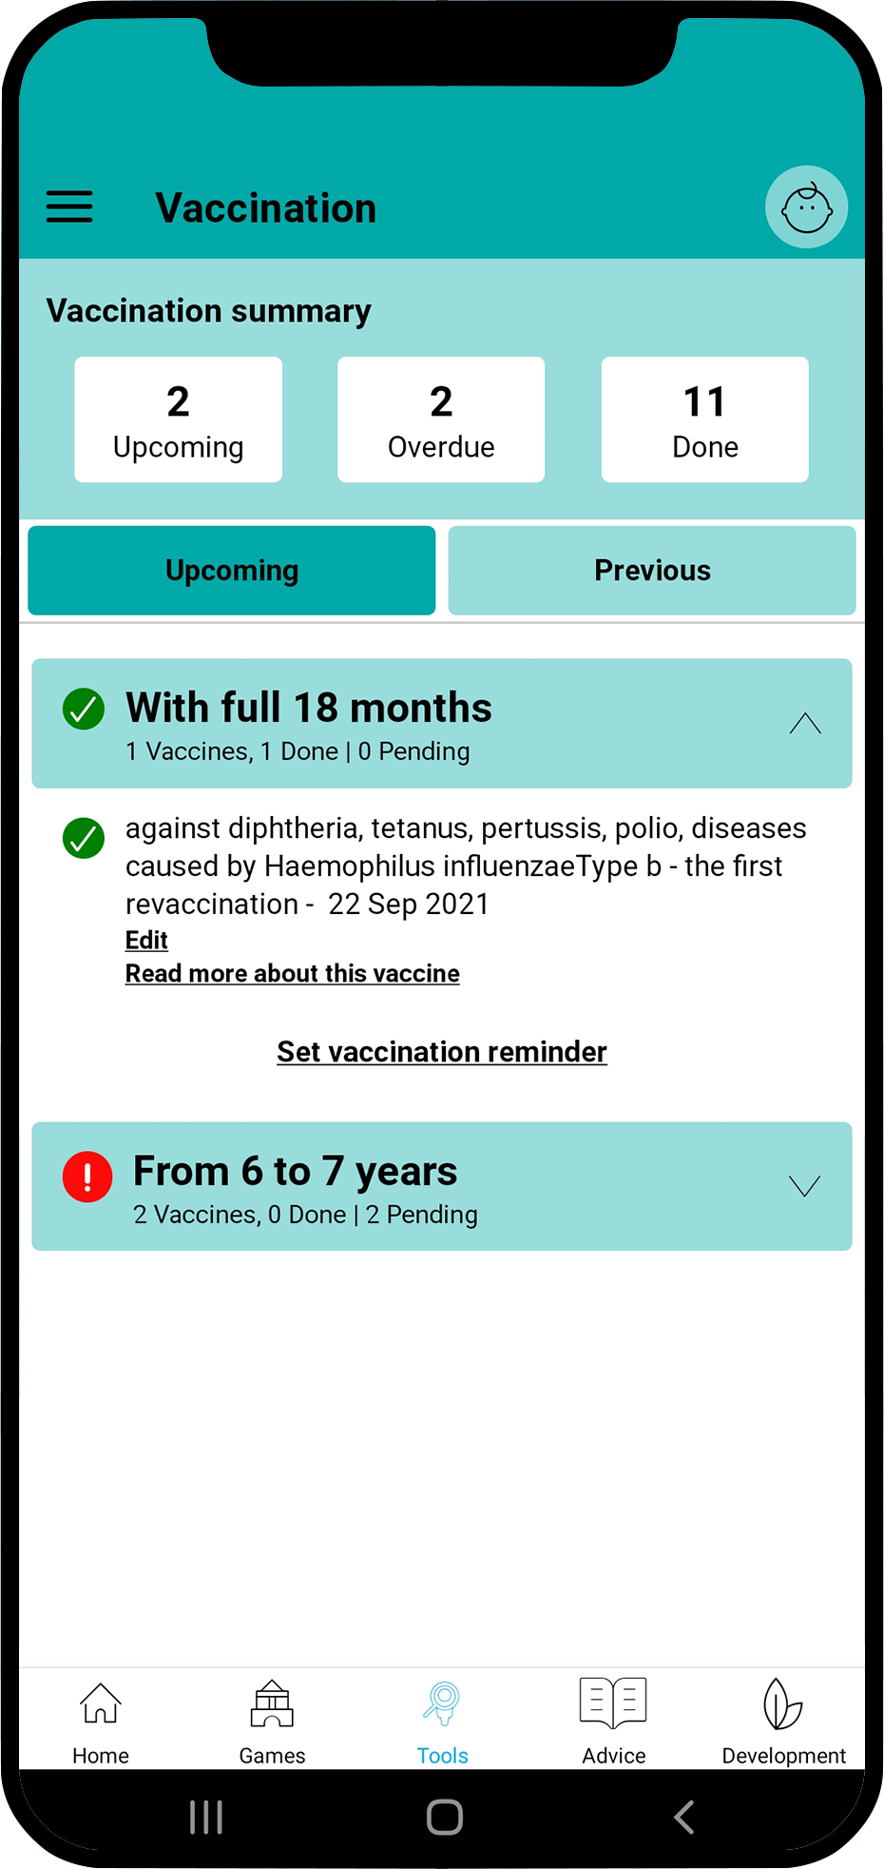
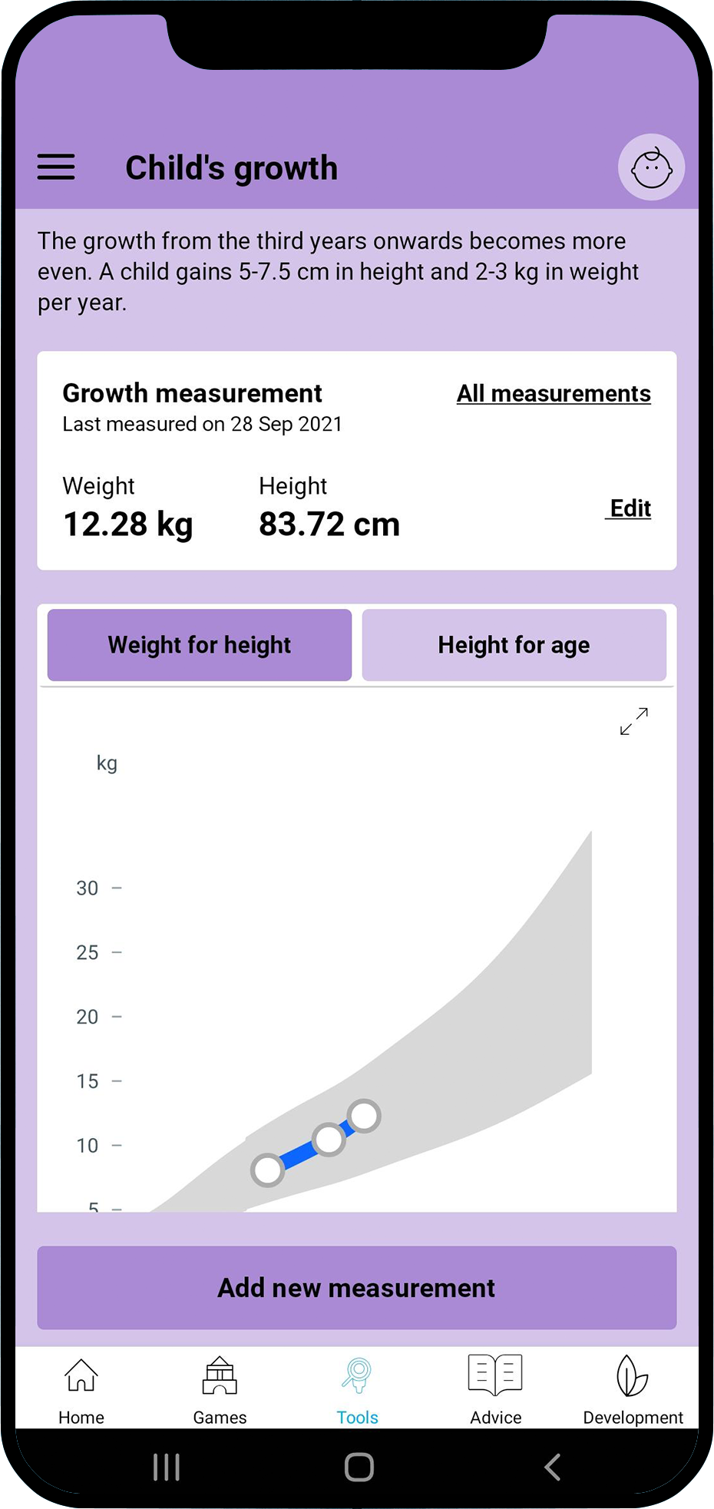
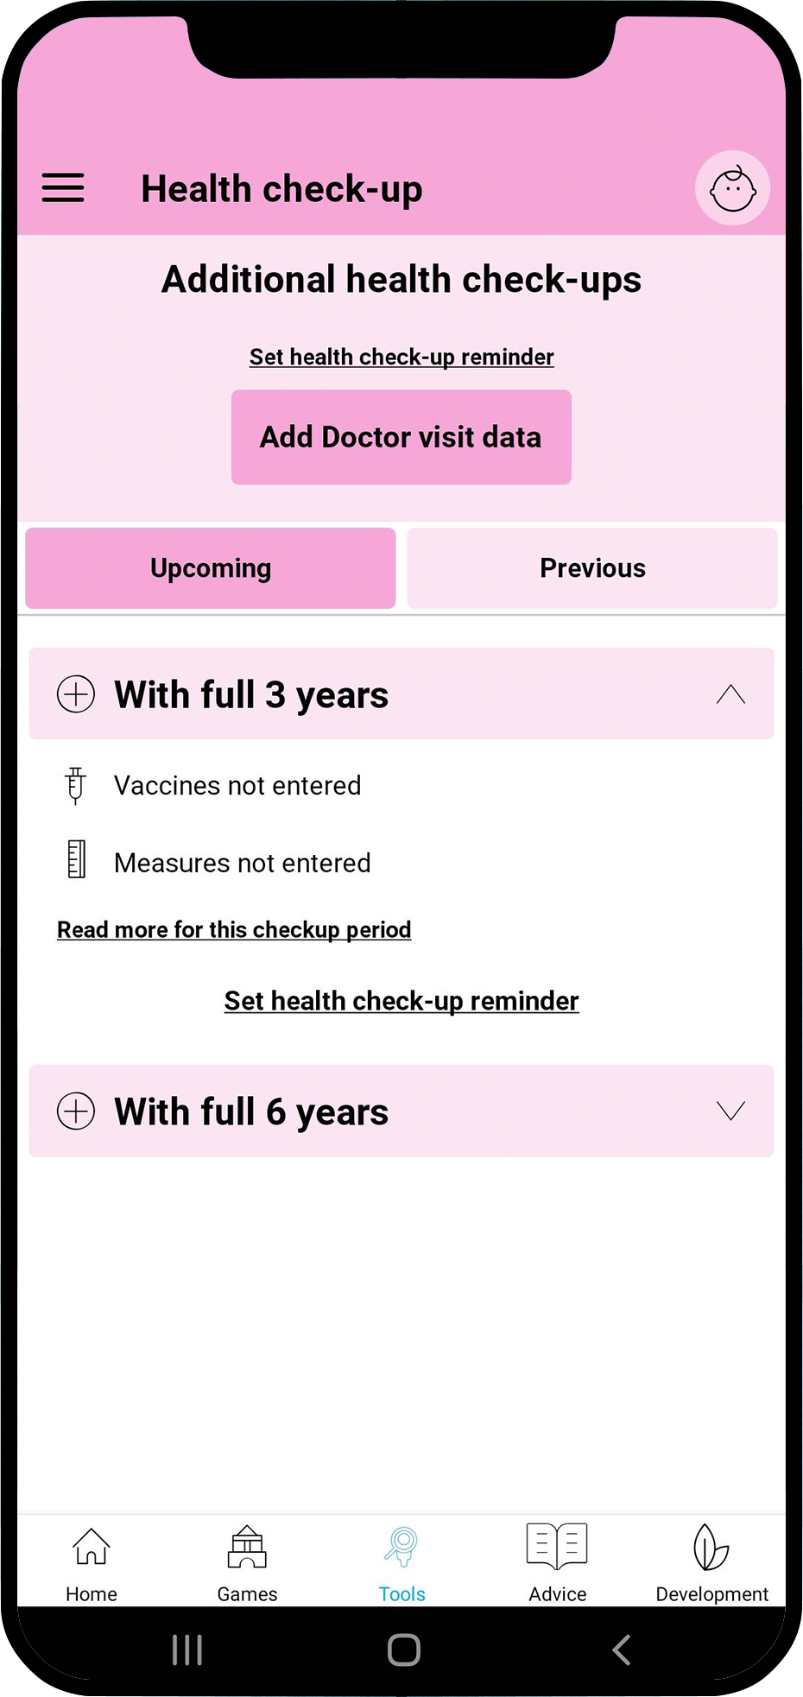
How does it work?
Parents or immediate caregivers enter basic details about their child (birthdate, gender), and start receiving information relevant to their child’s age and gender.
The app will prompt parents to actively record and monitor their child’s development and growth milestones. It will notify parents about upcoming vaccinations and health check-ups, with detailed information, and serve as a user-friendly repository of all records.
Parents will receive customized guidance on how they can further stimulate their young child’s development, introduce a more nutritious diet, or better understand the needs and behaviours of their children.

Slide 6
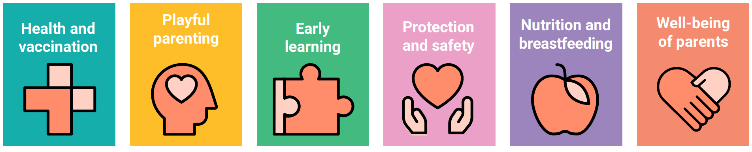

Bebbo app benefits
Monitor and support child’s development
Monitor and support optimal growth
Track and record health visits and immunization schedules
Content pushed to parents to the specific age and needs of their child
Advice library covering all domains of nurturing care
Two parents simultaneously can use it and set it up for more than one child
Open-source solution, free of charge for all users, without internal advertising
Available for Android and iOS mobile phones
6
6
6

Slide 7
The “localization” of the app in every country
1. Establishing technical partnerships for app deployment on a national level
      Government partners
      Expert groups
      Programme partners
2. Application contextualisation
      Content contextualization
      Interface customization
3. Application launch and promotion
      'Launch Toolkit'
      Partnerships package & business engagement opportunities
      M&E plans for the app and its launch/use
4. Application integration into ongoing CO programming
      Identify ways to integrate the app into the existing social services
App contextualization
App integration in CO programming
Technical Partnerships for app deployment
App Launch and Promotion

Slide 8

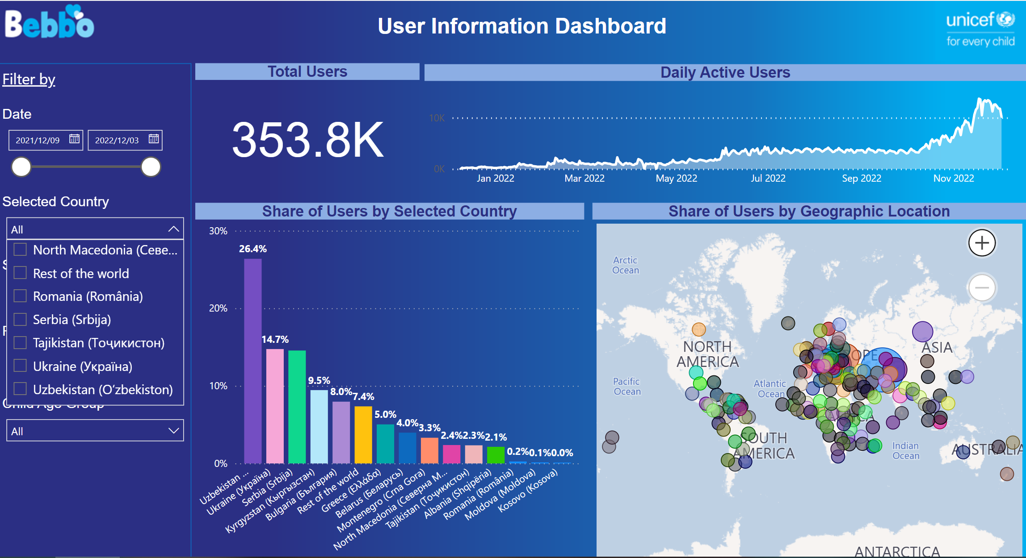

Slide 9
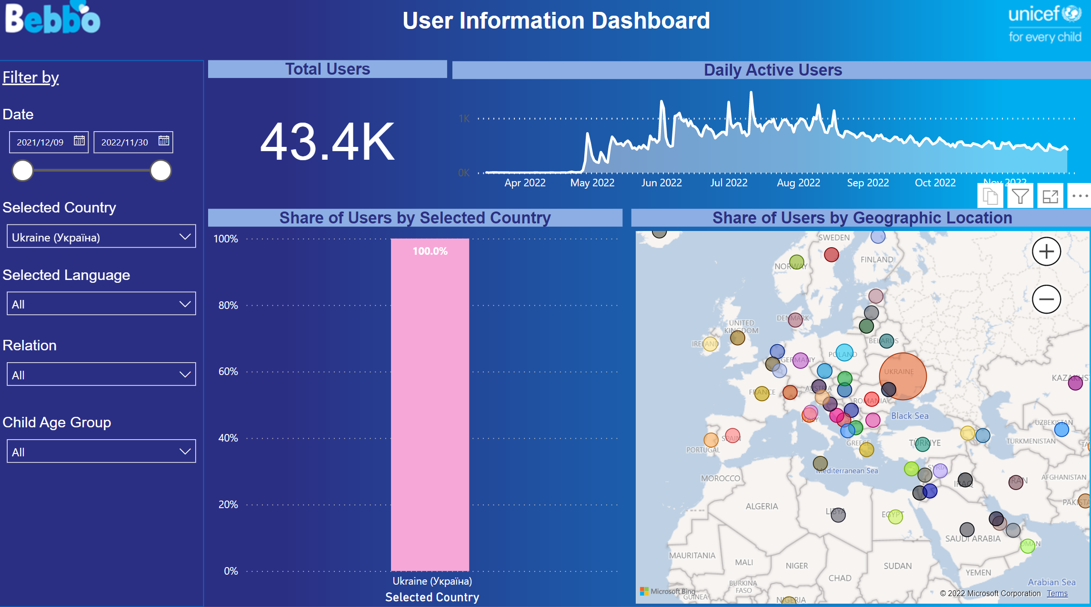
Ukraine

Slide 10

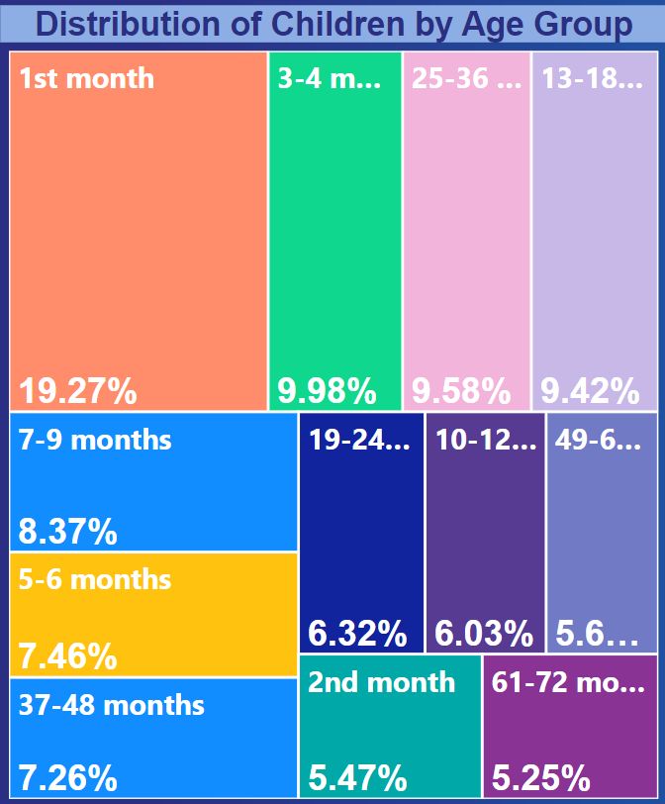
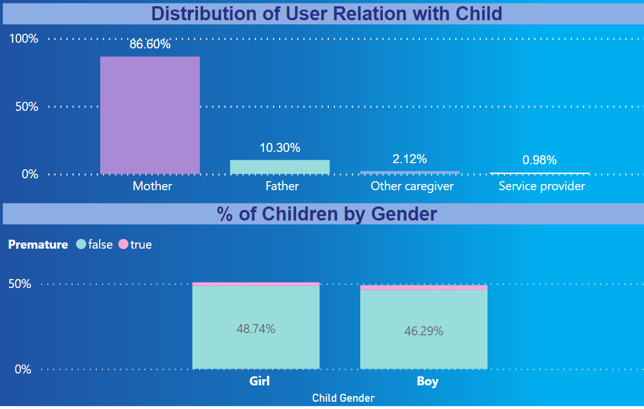
users

Slide 11
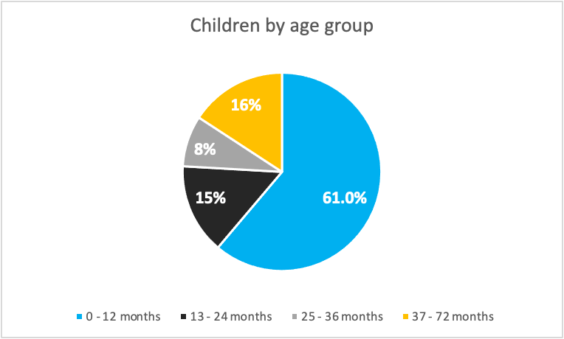
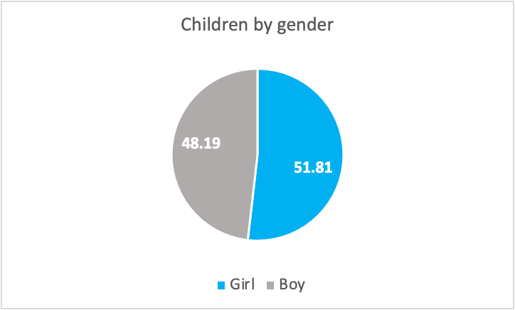
Who is using Bebbo

Slide 12
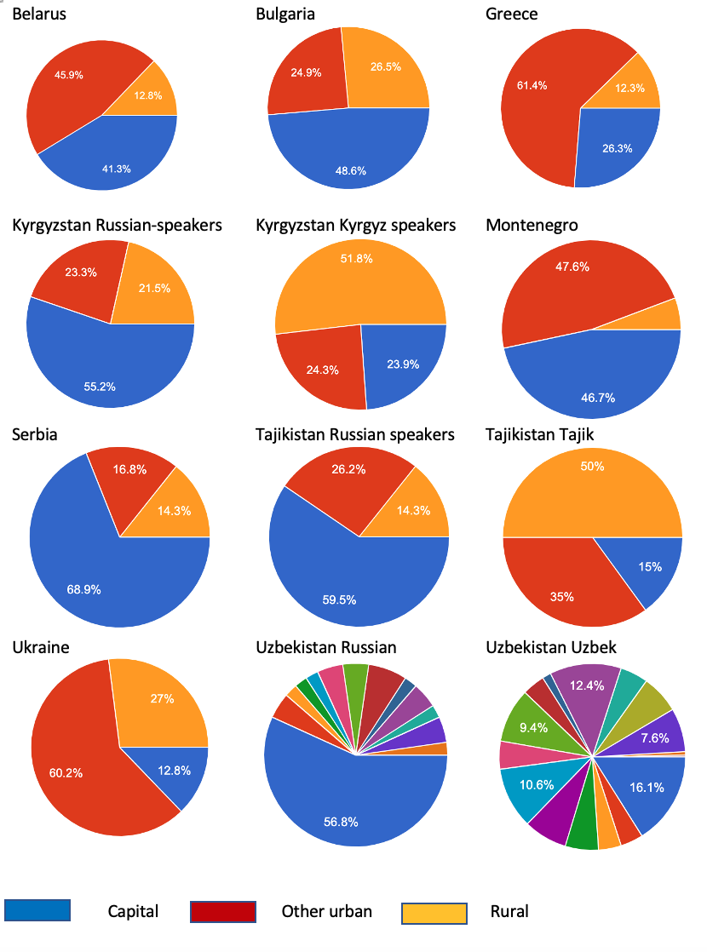

Who is using Bebbo

Slide 13


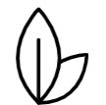


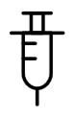
Use of various Bebbo features
Most popular article categories are child development followed by nutrition
Most popular game categories are language and development
Most popular articles and activities deal with caring for newborn children
67%
Is reading articles
Using games
41%
Tracking child development​
56%
​
21%
tracking growth​
tracking health check-up​s
Over 80% of Bebbo survey respondents report they are 'very satisfied' or 'satisfied' with Bebbo​!
15%
Tracking
vaccination
4%

Slide 14

What are parents saying about Bebbo?
“Since we discovered this application, which was introduced to us by the paediatrician when she paid a home visit to us, I feel confident I can care for my child in the right way. And my self-confidence kept increasing thanks to the information I access daily,”
Manjola, mother of two young children from Albania
“Given that we live in an era of internet communication and the rise of social networks, we tend to be overwhelmed with information and advice from various sources and are unable to immediately assess the reliability of some of the information. The Bebbo app saves me time and energy because everything I find in it comes from a credible institution, so I recommend it to all the parents I know“,
Maja, mother of a five year old girl, Montenegro
„I like the fact that you can set the data of both children and monitor their development depending on their age. There are also games that can help you develop certain skills if you doubt that the child needs a little more help“,
Polly, mother of two young children, Bulgaria

Slide 15
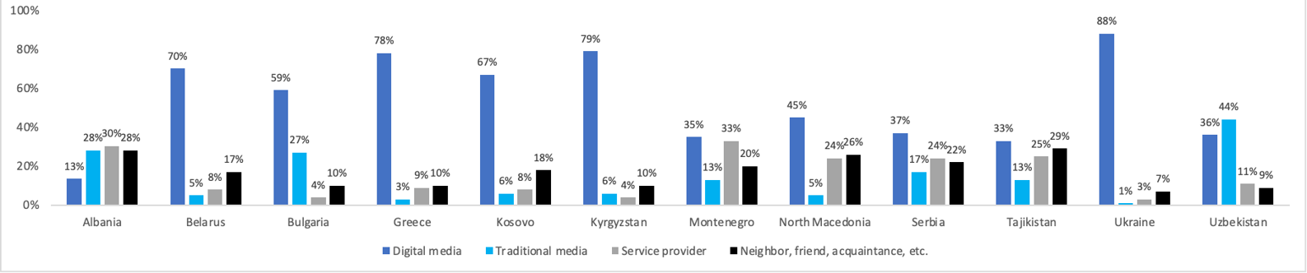
Main channels for reaching users
Digital media
(ads, posts, influencers, etc.) has brought in most of the new users. It is effective because the ability to target specific audiences is relatively easy.
Traditional media
is effective for brand awareness that leads to app installs, and it can be very effective when employed together with digital media
Service providers
in maternity wards, health centers, preschools etc. recommending Bebbo are trusted and contribute to overall brand image
Notes:
Key messages: ​
- Countries used a combination of channels for promotion of Bebbo (events, traditional media engagement, social media, digital marketing, word of mouth).​
- Most new users came through digital media, which is expected. And sometimes this was supported by events/traditional media.​
- Since this is a new product, new app - continuous promotion across channels is the key to its success and sustainability. Frequency and continuous exposure to Bebbo communication is key to building awareness and growing no. of app downloads. Channel mix is also an optimizing exercise – we are tracking data and continously learning what works better regionally and in each country.​
- It requires a cross sectoral office approach and a joint plan (digital specialists, comms, PFP where applicable, programme)​
- social media is new for UNICEF globally – thus we are putting extra effort on this but all channels are key​
Programme integration efforts is key for long term sustainability and can help reach the most vulnerable populations (although might not always translate into highest # of downloads)
Traditional media – it is important to ensure frequency of Bebbo messaging in traditional media to support digital media presence and marketing and brand building of Bebbo. We suggest to approach media (TV or radio) and ask for pro bono ad placements or negotiate packages with TV stations that are based on low value POs, using cheaper advertising slots – like early morning or children's TV. Another approach can include negotiating this with the national government partner to add leverage in negotiations (where applicable). Already available videos of 20 and 30 seconds for social media can be adapted for TV broadcasting.

Slide 16

Lessons learned
Regional solutions are cost-effective and great if responding to common challenges and needs across countries – must be built for scale
“Localization” of any digital solution is an imperative for deployment and sustainability
Digital solutions should not be stand alone or projectivized but fully integrated into programme interventions
Multiple partnerships are essential – for content, technology, promotion, sustainability, program integration
Continuous monitoring, feedback mechanisms and promotion through all channels are necessary for growth and sustainability

