Slide 1
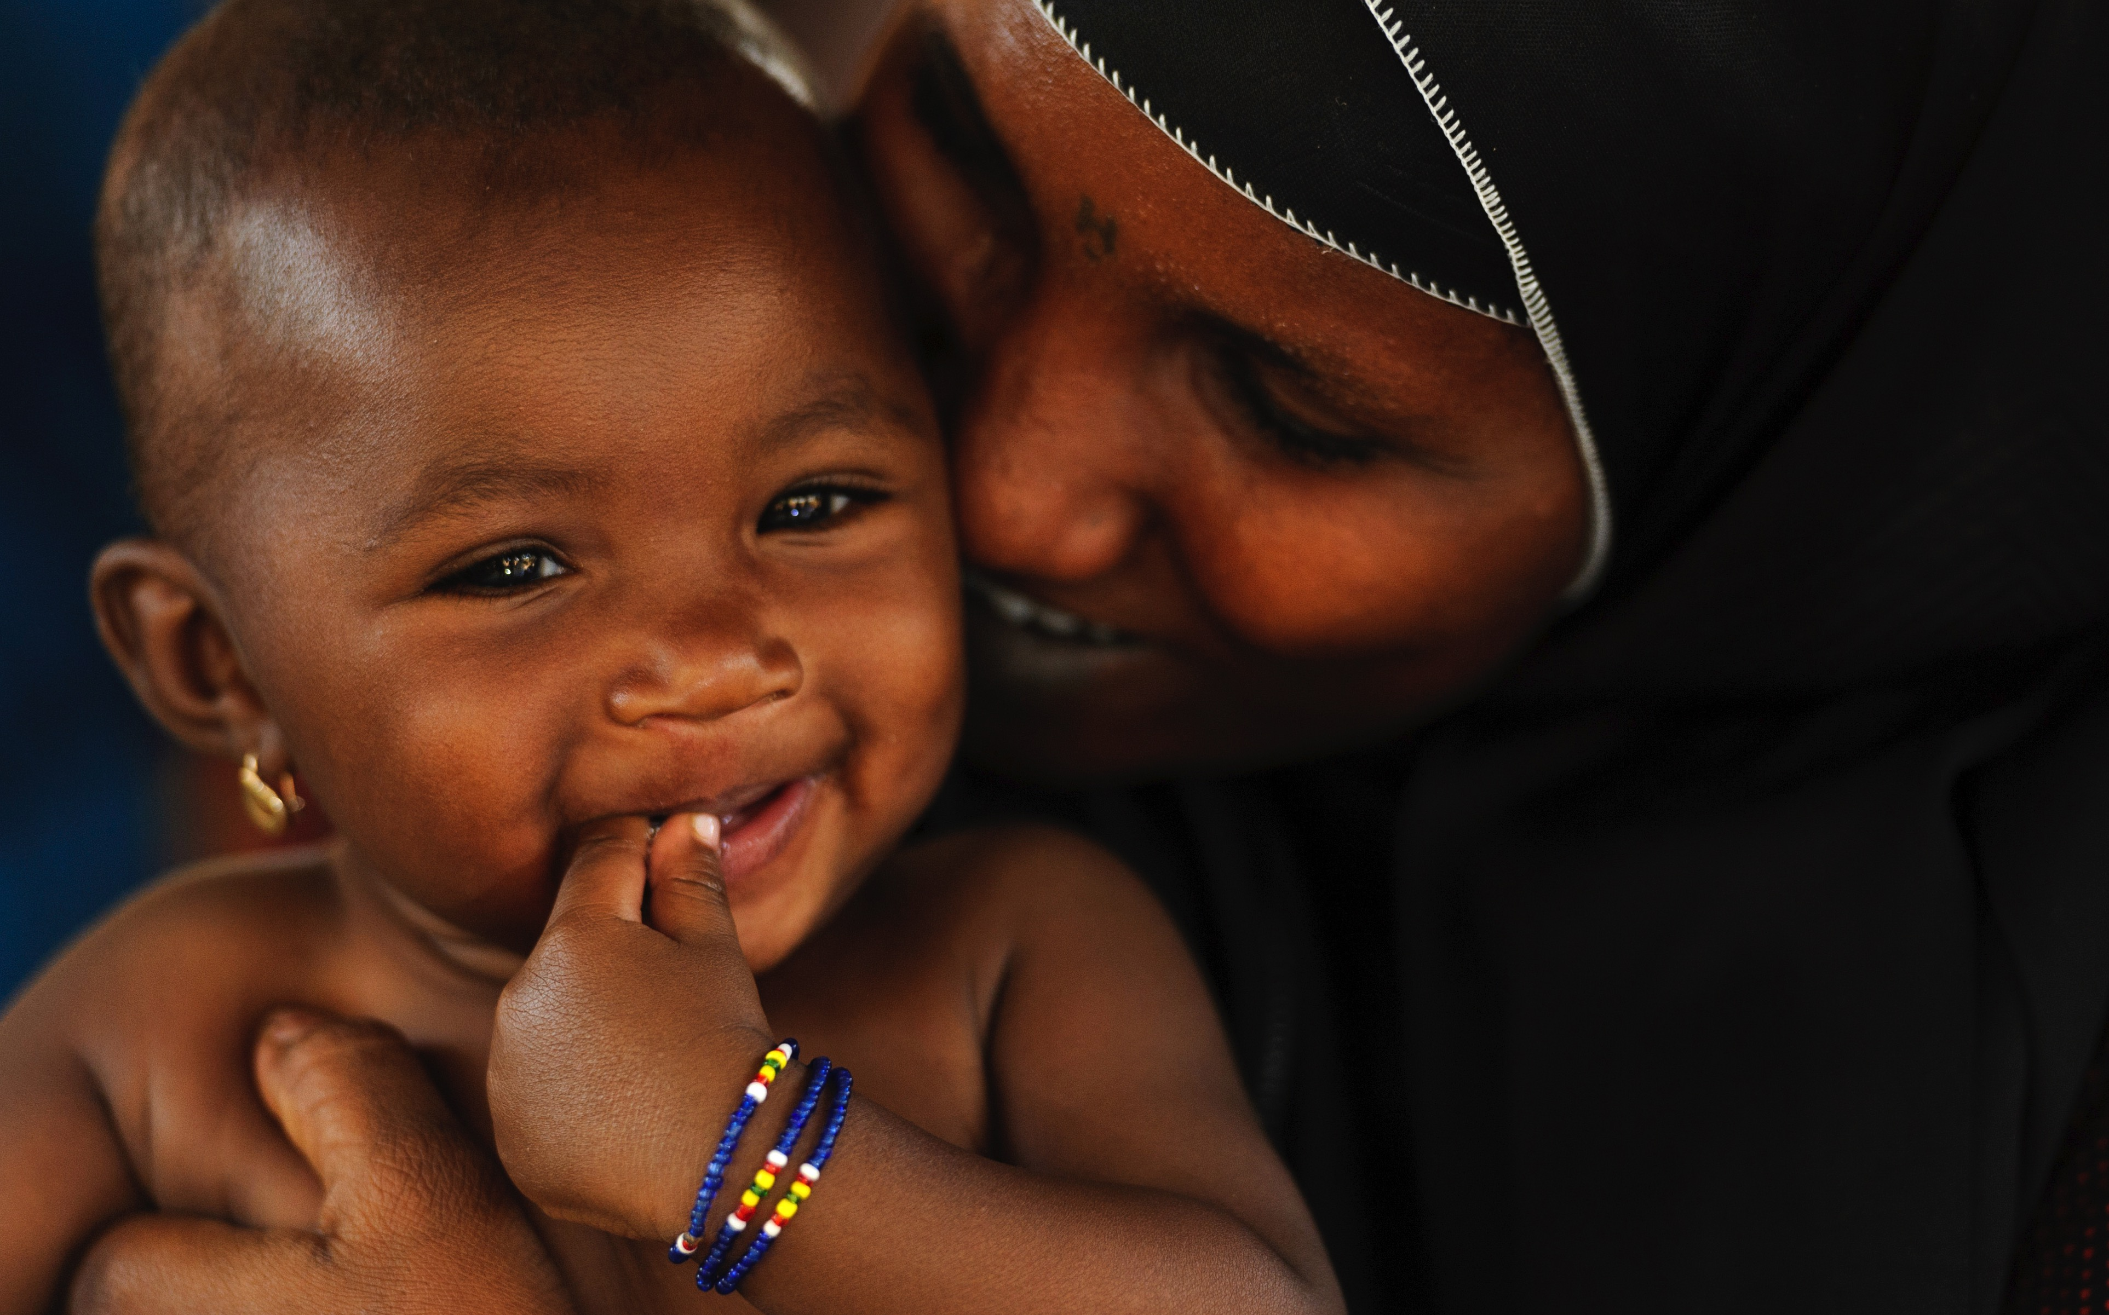

ECD
COUNTRY PROFILES
© UNICEF/UN053039/Luthi
A RESOURCE FOR MONITORING AND ACTION:
COUNTRY PROFILES ON EARLY CHILDHOOD DEVELOPMENT

Slide 2
^{Profiles launched in 2017}
They assemble in one place the latest information to assess and monitor country progress in improving the health, development and future prospects of young children all over the world
COUNTDOWN 2030 ECD COUNTRY PROFILES

Slide 3

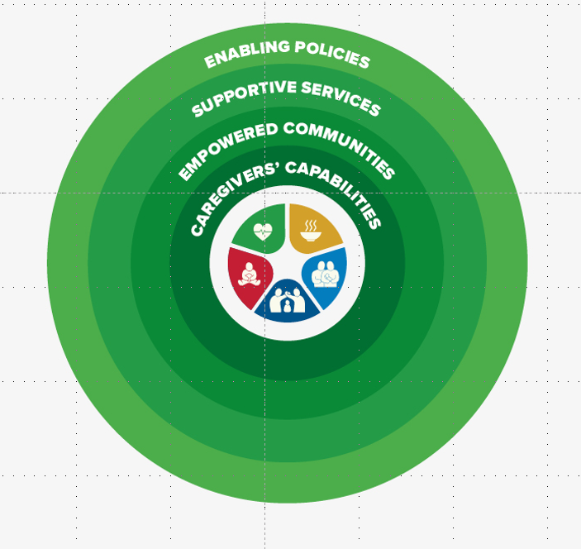
Based on the Nurturing Care Framework
Designed to support stakeholders in ECD
COUNTDOWN 2030 ECD COUNTRY PROFILES

Slide 4
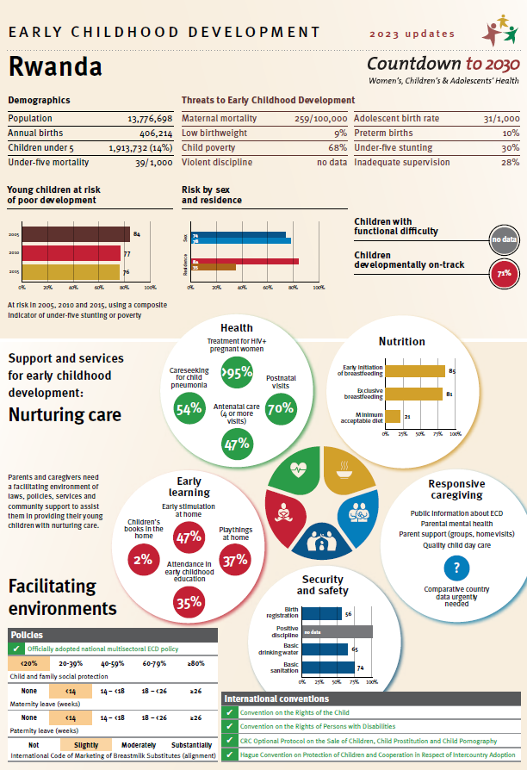
Demographics, threats to ECD
Outcomes/impact
2005-2015 trend in children at risk
Gender & residence differences
Children developmentally on track
Children with functional difficulties
5 components of nurturing care
Health
Nutrition
Security and safety
Early learning
Responsive caregiving (indicators and data to be defined)
Facilitating environment
Policies
International conventions
40 Indicators – one page
COUNTDOWN 2030 ECD COUNTRY PROFILES

Slide 5
^{Data for the Country Profiles}
Extracted from comparable and publicly available global indicator databases
UNICEF-supported Multiple Indicator Cluster Surveys (MICS)
USAID-supported Demographic and Health Surveys (DHS)
Other nationally representative household surveys, censuses
Agreed modelled estimates (e.g., stunting)
Country data published in high impact journals
Accompanied by a Technical Appendix with indicator definitions, together with the underlying Excel database
COUNTDOWN 2030 ECD COUNTRY PROFILES

Slide 6



Nurturing Care has Grown Solidly…
COUNTDOWN 2030 ECD COUNTRY PROFILES

Slide 7
As have the ECD Country Profiles…
2018
The first ECD Country Profiles included data for 91 low- and middle-income countries
2019
The profiles were updated and expanded to 138 low- and middle-income countries
2020
The profiles were updated and extended to 197 countries, including 63 high-income countries
2021-2025
Profiles are updated and produced bi-annually
COUNTDOWN 2030 ECD COUNTRY PROFILES

Slide 8
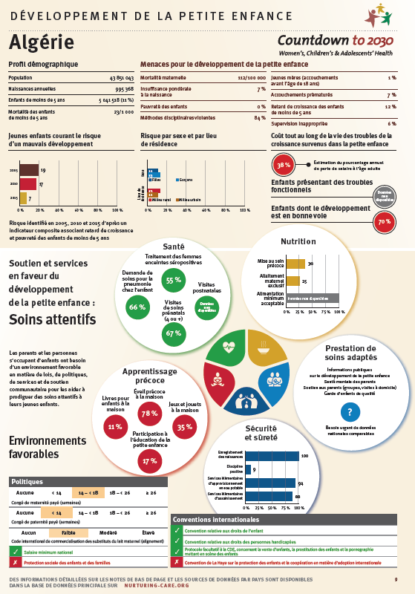
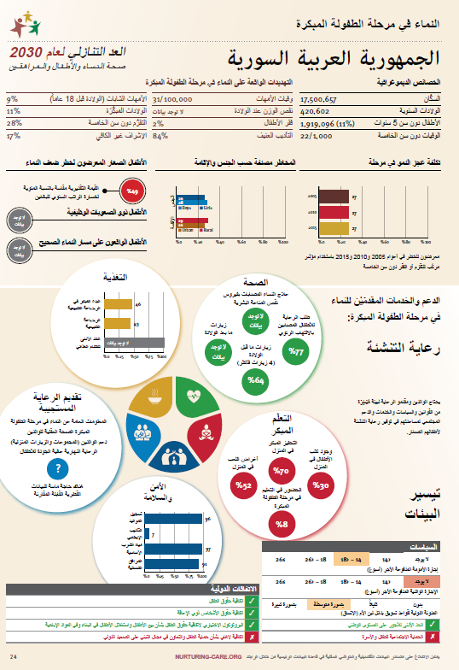
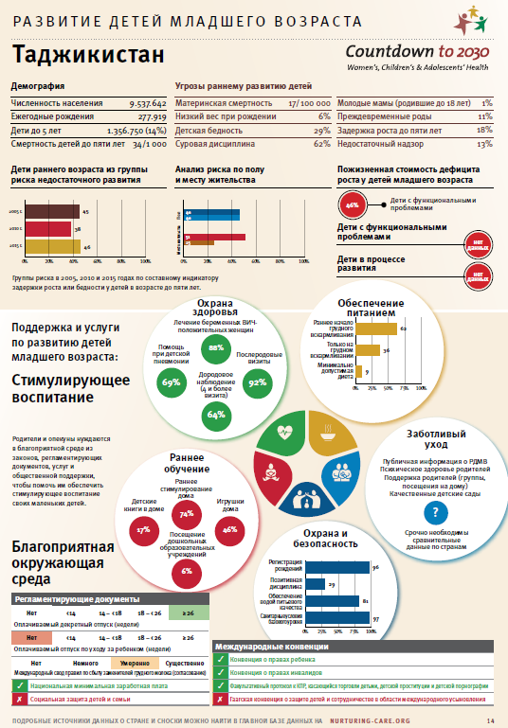
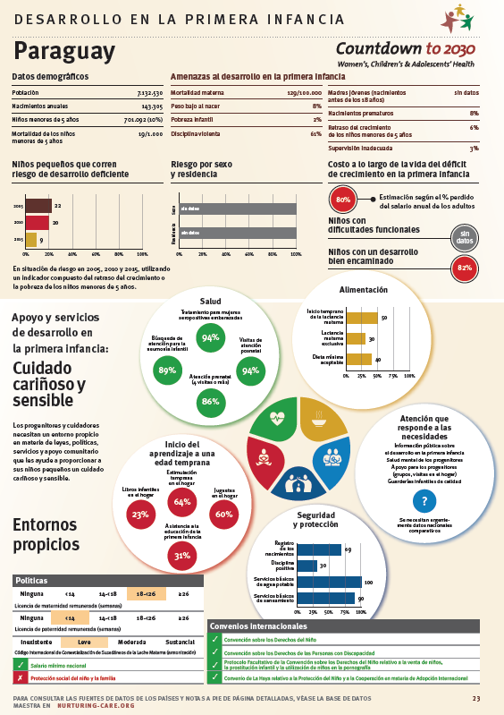
^{Dissemination - Translations}
5 Languages: Arabic, English, French, Russian and Spanish
COUNTDOWN 2030 ECD COUNTRY PROFILES

Slide 9
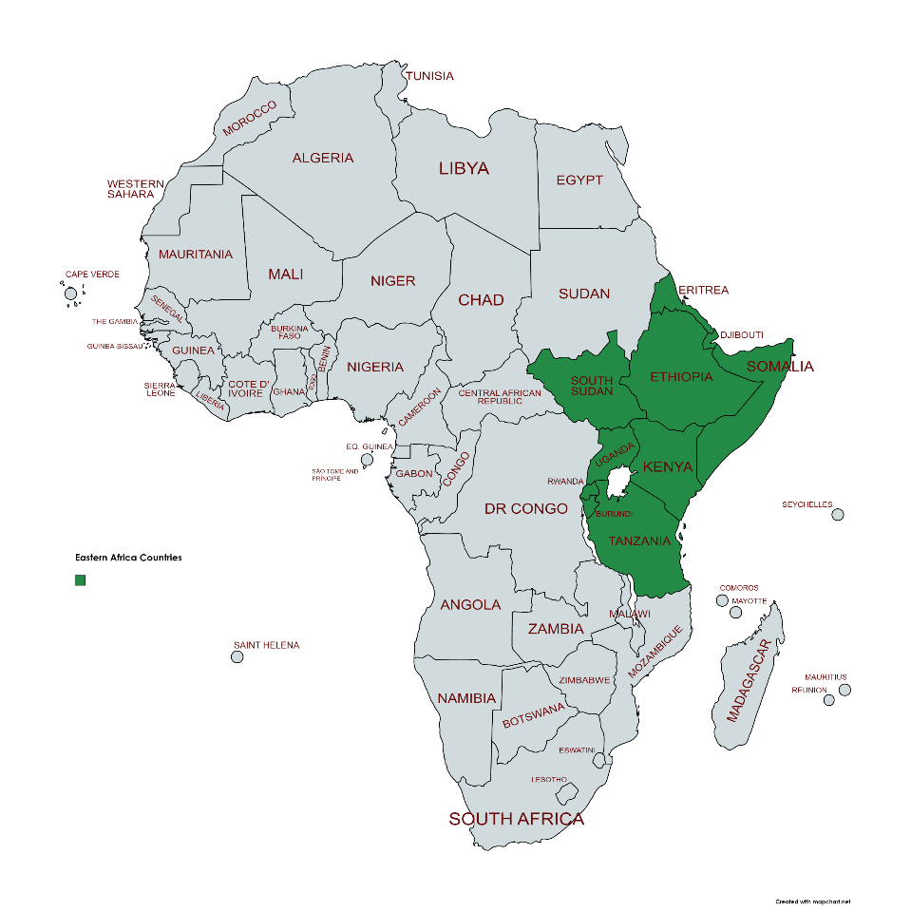
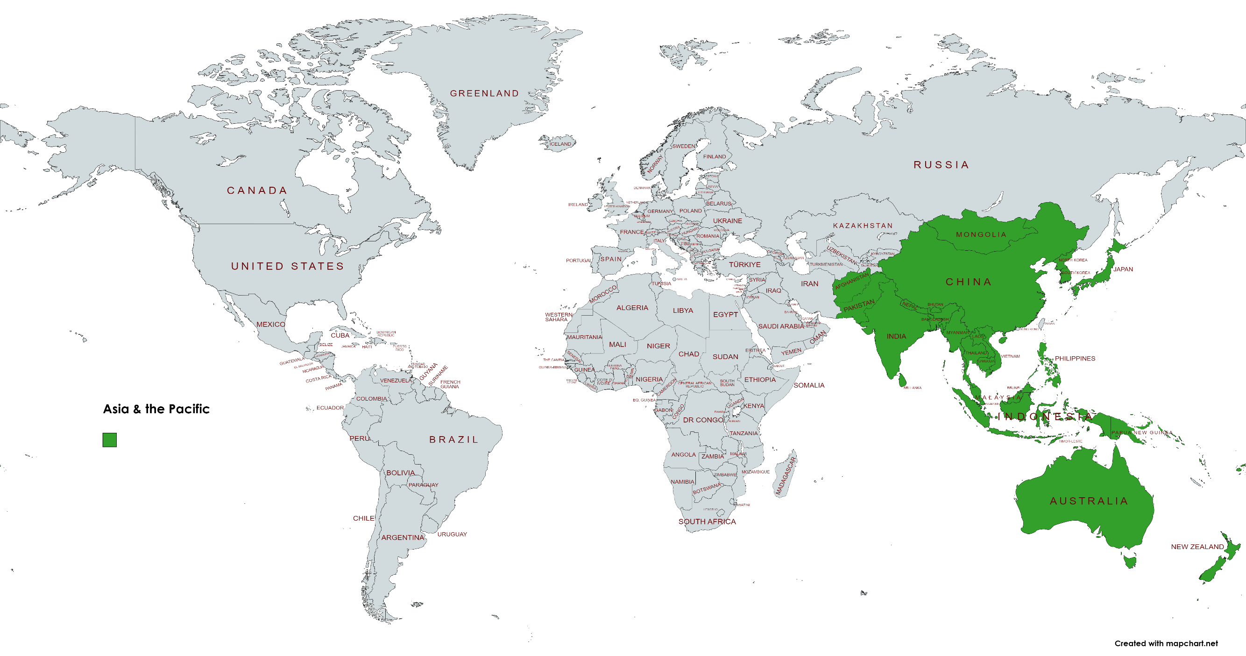
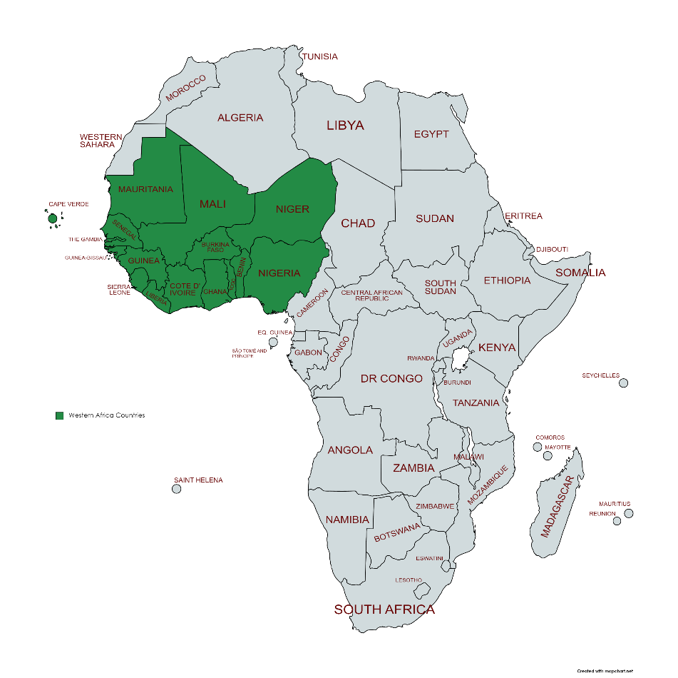
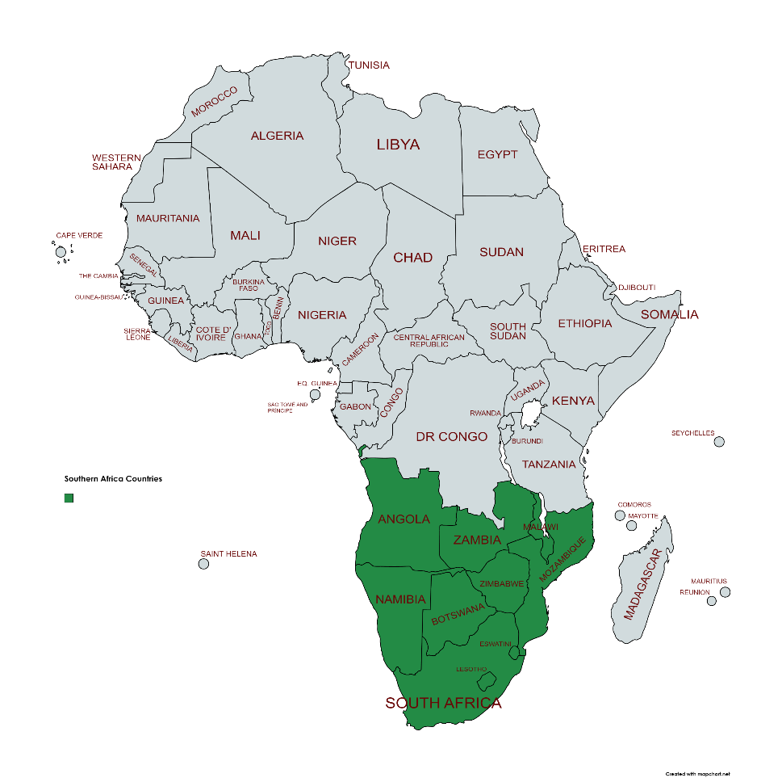
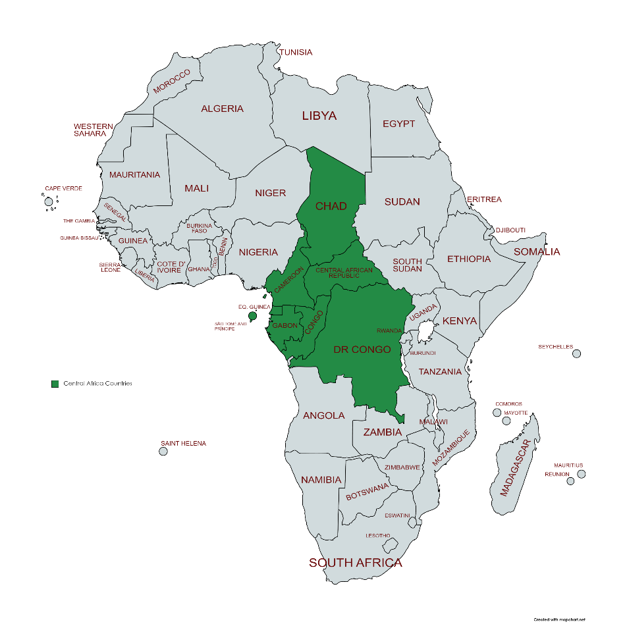
Dissemination – Regional Profiles
Asia/Pacific: 41 countries, 320m <5 children
West Africa:
16 countries
66m <5 children
Central Africa:
8 countries, 25m <5 children
S Africa:
10 countries, 30m <5 children
East Africa:
10 countries, 50m <5 children
COUNTDOWN 2030 ECD COUNTRY PROFILES

Slide 10
Egs of Regional and Country Presentations
^{WHO, Geneva, 2017}
^{Stellenbosch, 2018}
^{ECD Conference, Nairobi 2018}
^{UNGA, 2019}
^{SEARO, 2021}
^{ARNEC Conference,2022}
^{CD Launch, 2023}
^{ECD Conference, Kigali 2023}
Government representatives, CSOs, parent groups, funders, foundations
COUNTDOWN 2030 ECD COUNTRY PROFILES

Slide 11
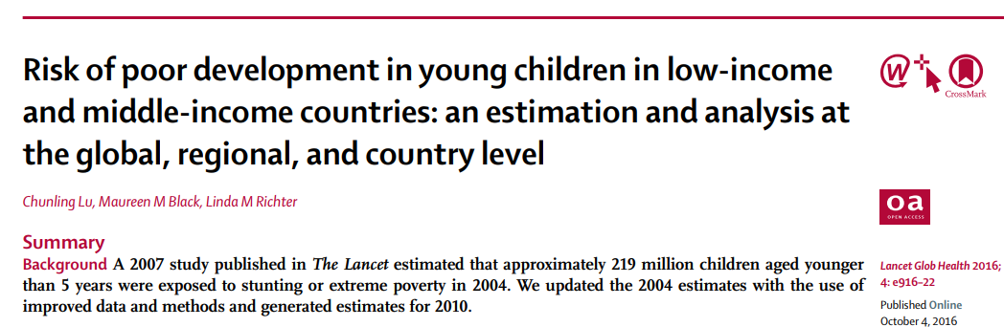
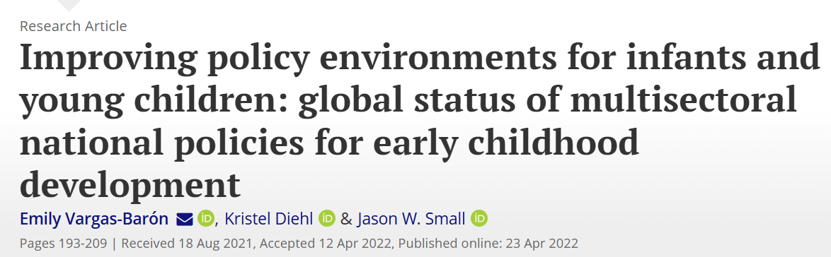
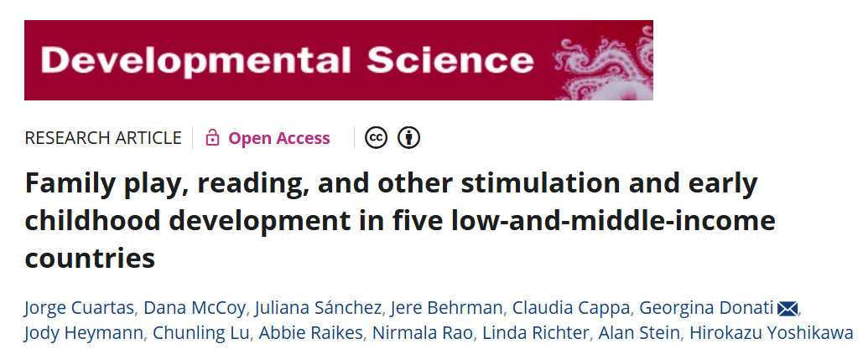

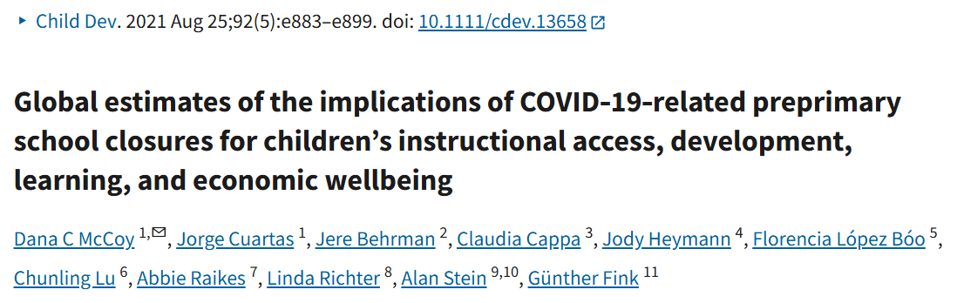
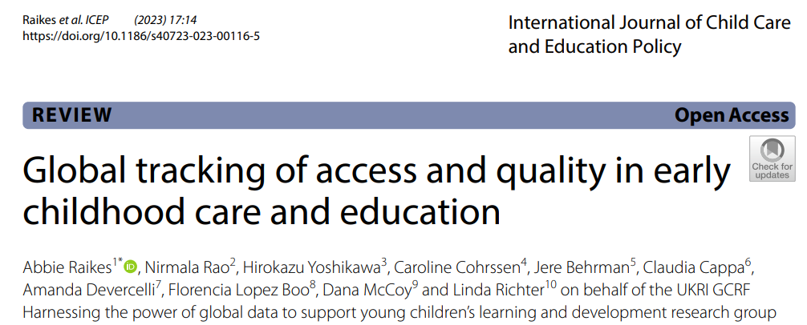
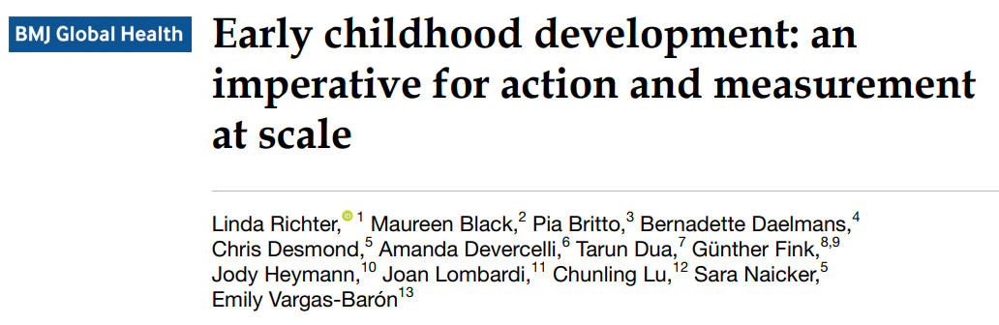
^{Examples of Publications}
COUNTDOWN 2030 ECD COUNTRY PROFILES

Slide 12
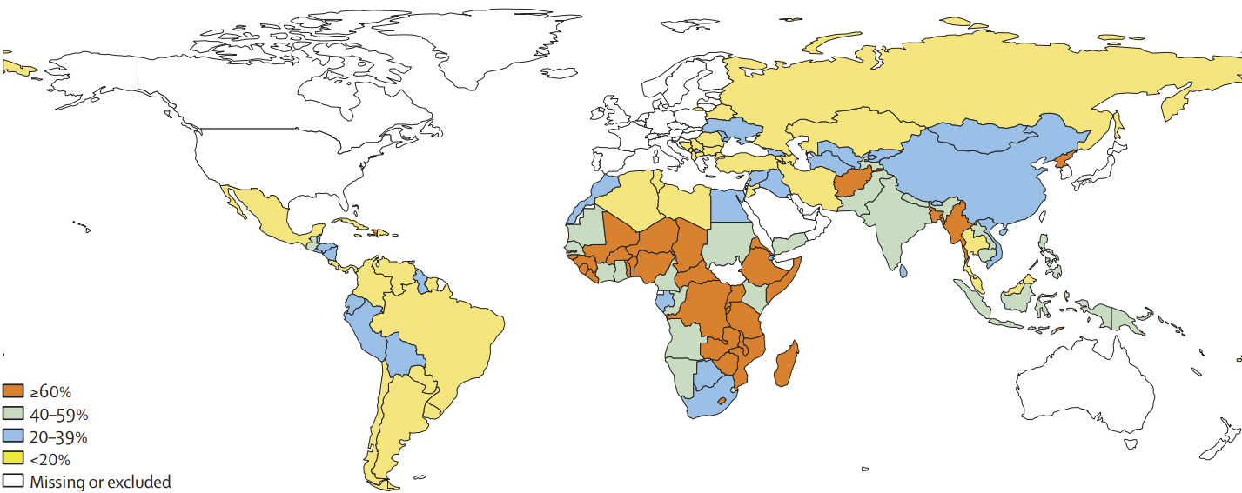
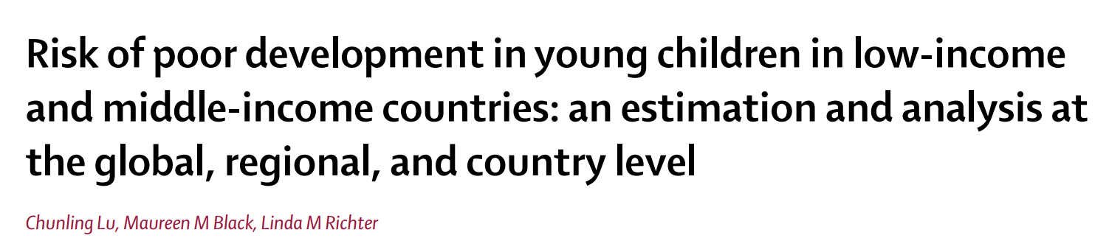
Data Raises Awareness
In low- and middle-income countries across the world, 250 million children (43%) under the age of five are at risk of not reaching their developmental potential because of poverty and stunting
Double count
Extreme poverty
Stunted
Lancet Global Health (2016), 4, 916-922
COUNTDOWN 2030 ECD COUNTRY PROFILES

Slide 13
^{Data Uses}
Highlight disparities – regions, countries, locations, gender
Encourage uptake through focus and relevance
Facilitate knowledge sharing and learning across regions and countries
^{Foster local research}
Tailor advocacy efforts to key issues
COUNTDOWN 2030 ECD COUNTRY PROFILES

Slide 14
^{Leveraging the ECD Profiles}
A high-quality, largely untapped resource for countries to identify key data gaps, monitor progress over time and propel action for change
Expand global data collection – eg optional ECD DHS module
Country investment is needed for regular data collection on a standard set of indicators to fill data gaps and generate data to assess trends
Accelerated efforts to collect, use & disseminate data to improve outcomes for young children in the last five years of the SDG agenda to 2030
COUNTDOWN 2030 ECD COUNTRY PROFILES

Slide 15
^{Updates in 2025…}
TWG to undertake a comprehensive review of existing indicators and data sources to ensure the profiles reflect the critical drivers of ECD and what is needed for young children to thrive
Possible further refinement of some indicator definitions (e.g., maternity leave) and data sources (e.g., child poverty)
Updated estimates on % of children at risk of not reaching developmental potential - expected to be released in Q4 of 2025
COUNTDOWN 2030 ECD COUNTRY PROFILES

Slide 16


Download Country Profiles & Database
https://data.unicef.org/resources/countdown-to-2030-ecd-country-profiles/
https://www.countdown2030.org/early-childhood-development-profiles%20
https://www.ecdan.org/countries.html
https://nurturing-care.org/resources/country-profiles

